Slide 1

Industry Project Presentation on “SecureSys: Strengthening Infrastructure Security & Monitoring”
By
Abel Benedict (20162171001)
Institute of Computer Technology, Ganpat University
Date: 01-04-2024

Slide 2
Table of Contents
Introduction
Objectives
Related Background
Expected Outcome
Tools & Technology
Methodology (Modules)
Design / Diagrams & TimeLine Charts with Milestones
Flowchart & Algorithms
Implementation Details
Conclusion
References
(Extra Can be Added/removed as per your Project Requirement)

Slide 3
Introduction
This presentation outlines the successful implementation of a centralized logging and monitoring system using the ELK stack (Elasticsearch, Logstash, Kibana). The project aimed to enhance security and visibility by aggregating, analyzing, and visualizing log data from diverse sources across the organization's infrastructure.

Slide 4
Objectives
Install and configure Elasticsearch, Logstash, and Kibana.
Collect, parse, and forward logs from various sources to Elasticsearch.
Optimize storage and indexing in Elasticsearch.
Visualize log data and create custom dashboards in Kibana.

Slide 5
Related Background
Prior to the project initiation, the organization recognized the need for comprehensive logging and monitoring capabilities to detect and mitigate security threats effectively. This project aimed to address this need by implementing a centralized solution for log aggregation and analysis.

Slide 6
Expected Outcome
The expected outcome of this project include:
Enhanced security through real-time monitoring of system activities.
Improved visibility into security incidents and operational issues.
Streamlined log management processes for efficient troubleshooting and analysis.

Slide 7
Tools & Technology
Elasticsearch: Scalable storage and indexing of log data.
Logstash: Log collection, parsing, and forwarding.
Kibana: Visualization and analysis of log data.

Slide 8
Methodology (Modules)
Installation and Setup of ELK Stack Components
Log Collection and Parsing with Logstash
Indexing and Storage Optimization in Elasticsearch
Visualization and Monitoring Setup with Kibana

Slide 9
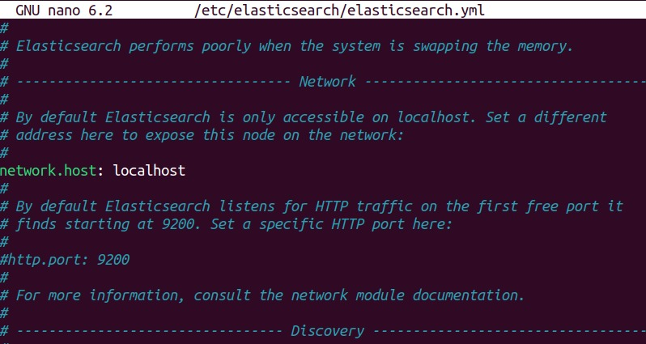

Slide 10
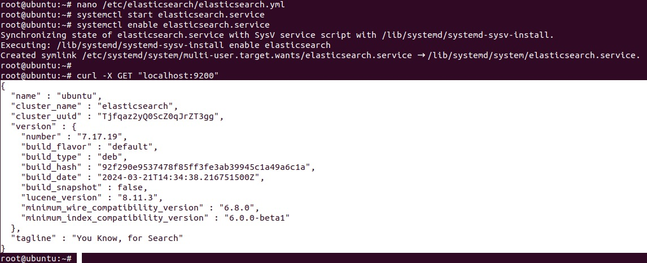

Slide 11
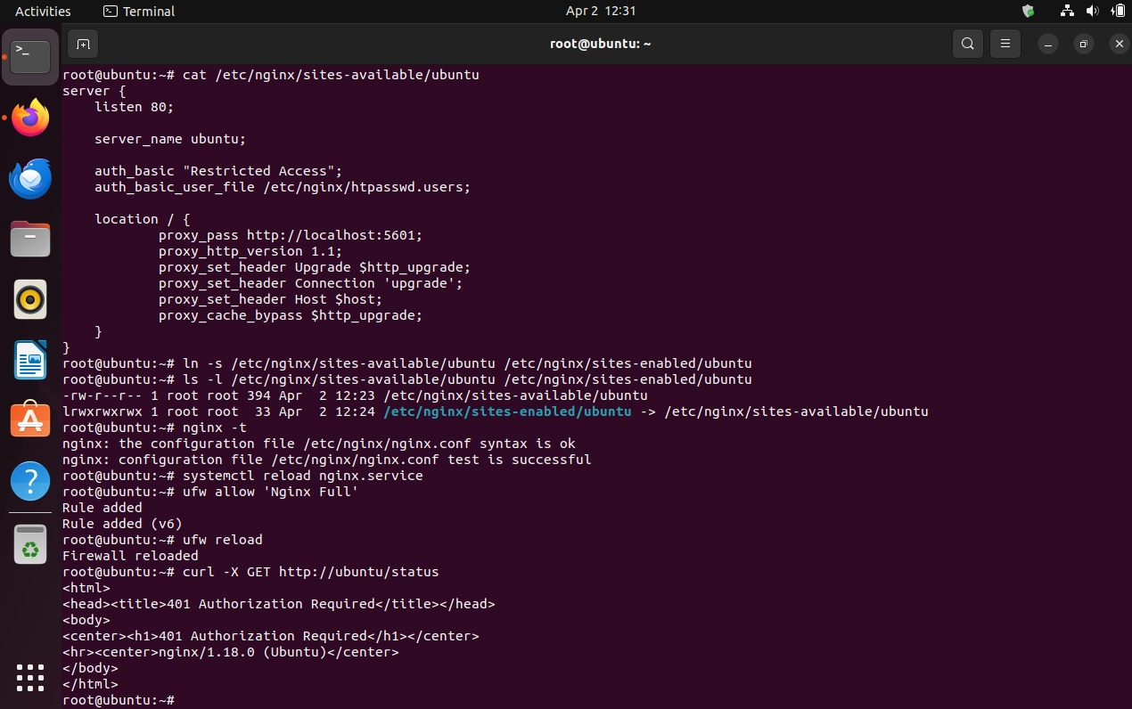

Slide 12
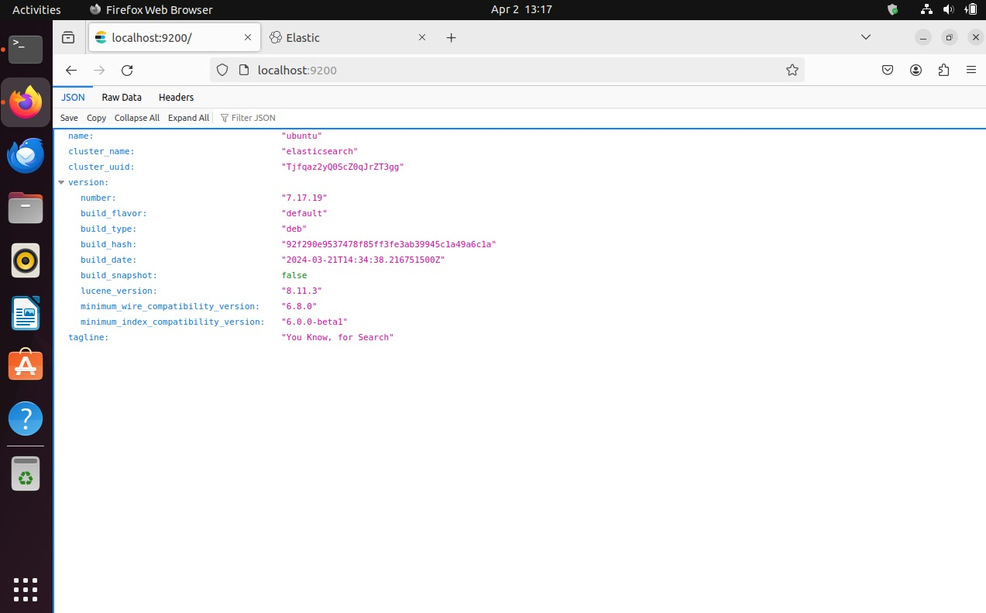

Slide 13
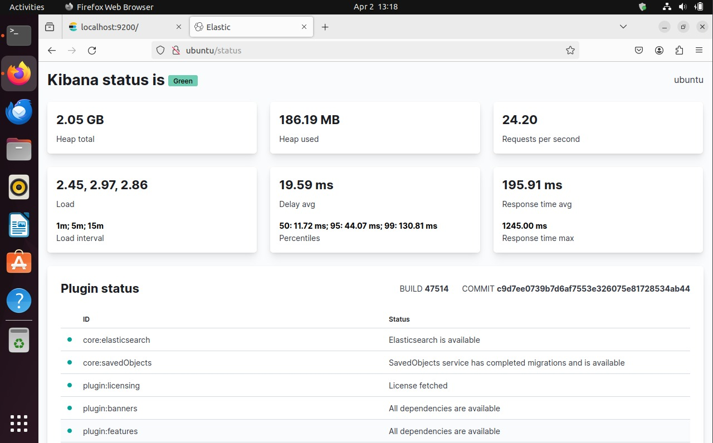

Slide 14
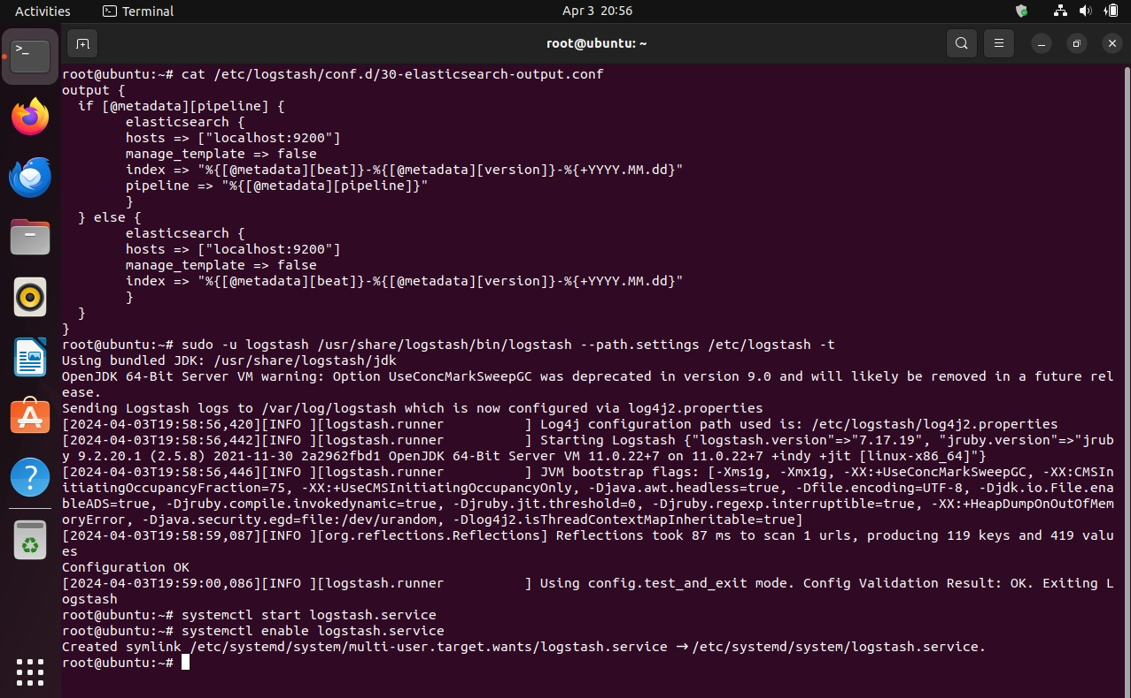

Slide 15
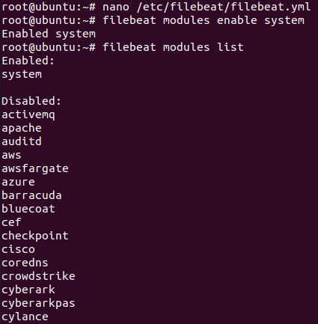

Slide 16
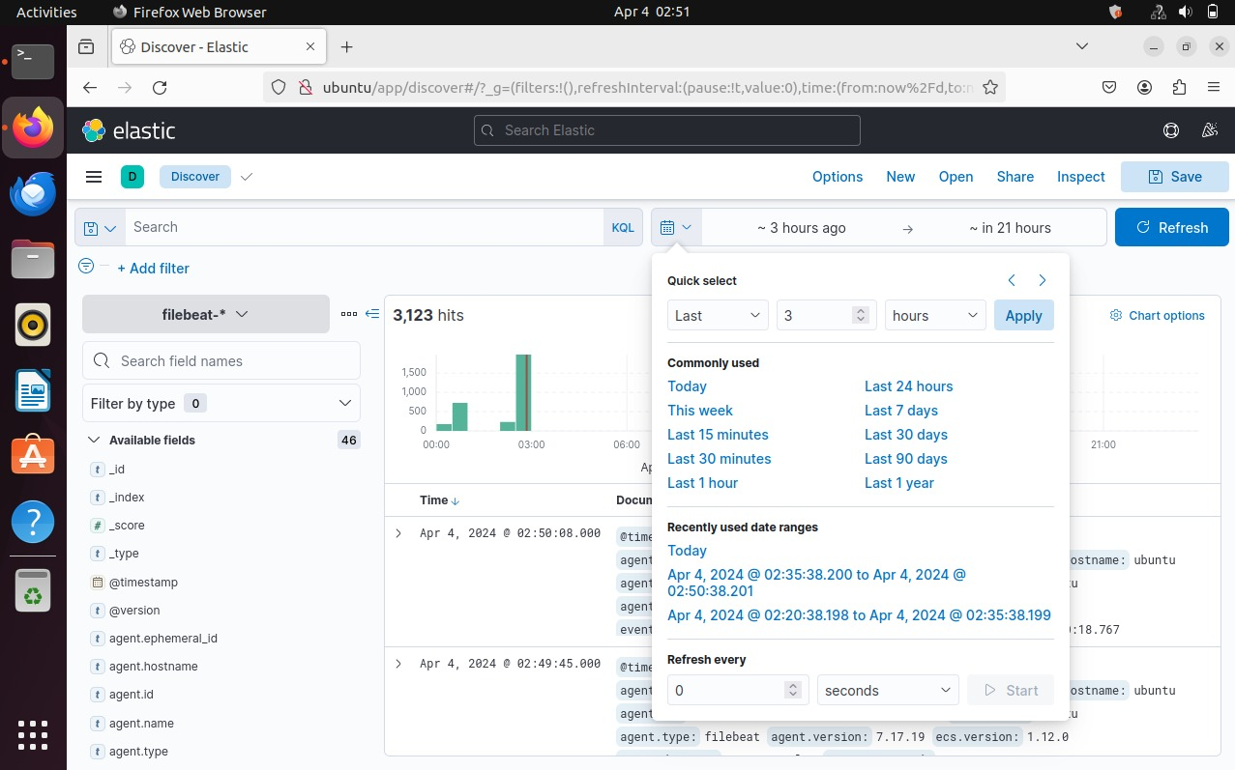

Slide 17
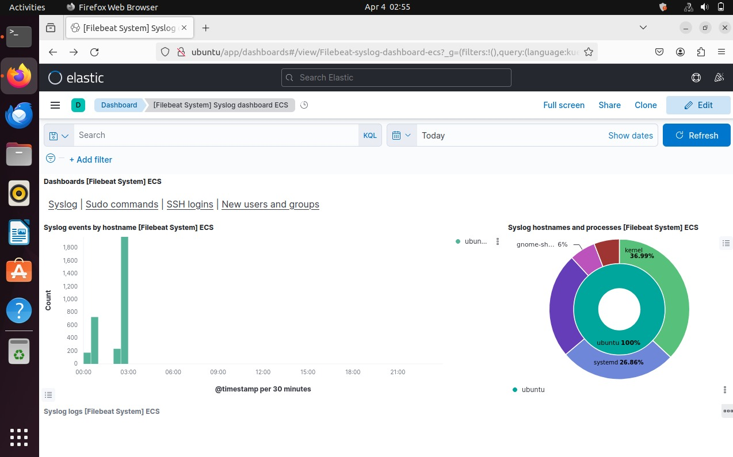

Slide 18
Implementation Details
Week 1: Installation and initial configuration of ELK stack components.
Week 2: Log collection and parsing setup with Logstash.
Week 3: Indexing and storage optimization in Elasticsearch.
Week 4: Visualization and monitoring setup with Kibana.

Slide 19
Conclusion
The successful implementation of the centralized logging and monitoring system with the ELK stack has significantly strengthened our organization's security posture and operational resilience. By aggregating, analyzing, and visualizing log data, we have gained valuable insights into system activities and security events, empowering us to detect and respond to threats effectively.

Slide 20
References
Elastic (2024). Elasticsearch Reference. Retrieved from https://www.elastic.co/guide/en/elasticsearch/reference/current/index.html
Elastic (2024). Logstash Reference. Retrieved from https://www.elastic.co/guide/en/logstash/current/index.html
Elastic (2024). Kibana User Guide. Retrieved from https://www.elastic.co/guide/en/kibana/current/index.html

Slide 21
Thank You !!

